Slide 1
Maps in P0
Faisal Jaffer
Usman Asad
Aleem Haq
04/2021

Slide 2
Topic
Extend the P0 compiler with (typed) maps.

Slide 3
Challenge
At runtime the size of the map may increase
Hash table needs to be managed on WebAssembly memory
Guarantee constant time for lookup
Guarantee constant time for deletion
Guarantee amortized constant time of insertion

Slide 4
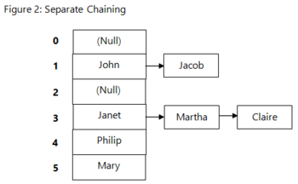
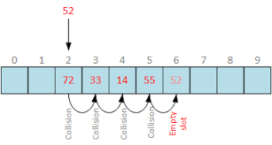
Types of Hashing
Separate Hashing
Lookup time: O(N) (worst)
Open Addressing
Lookup time: O(N) (worst)

Slide 5
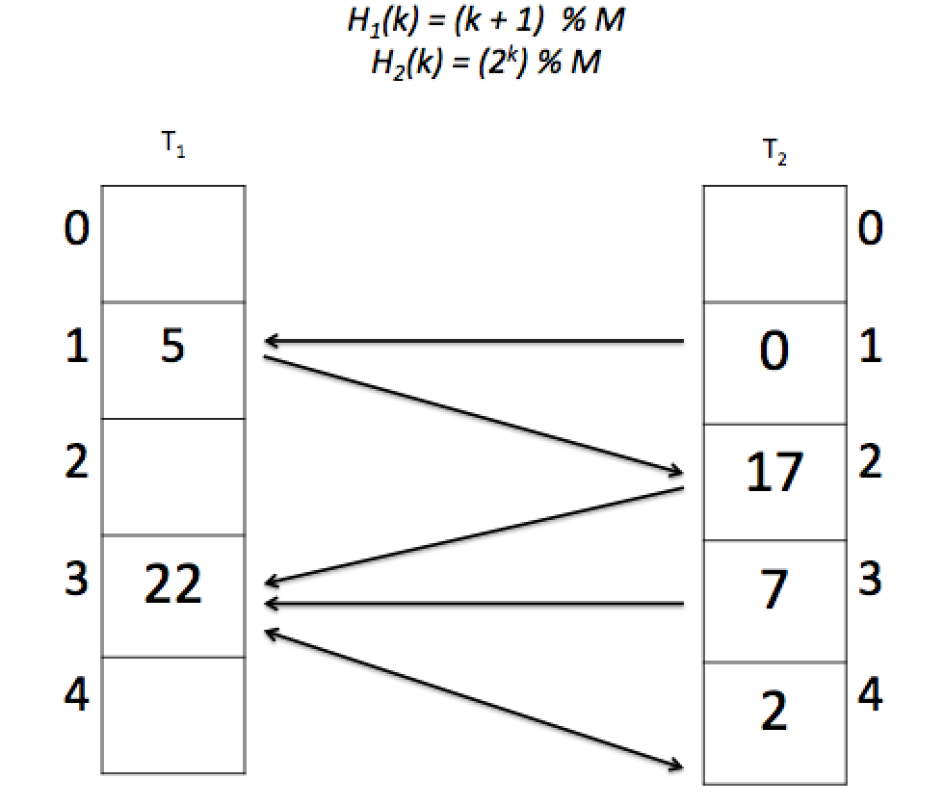
Cuckoo Hashing
Lookup time: constant (worst)
Insertion time: constant (amortized)
Deletion time: constant (worst)

Slide 6
Existing Implementation
https://github.com/DeborahHier/CuckooHash/blob/master/CuckooHash.py

Slide 7
Cuckoo Hashing
If map starts to fill up, we need to reallocate tables with larger sizes and re-insert entries.
If there is a loop in the displacements of nodes, we need to reallocate tables with larger sizes and re-insert entries.

Slide 8
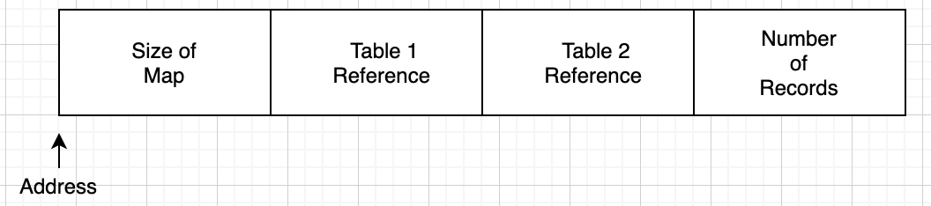
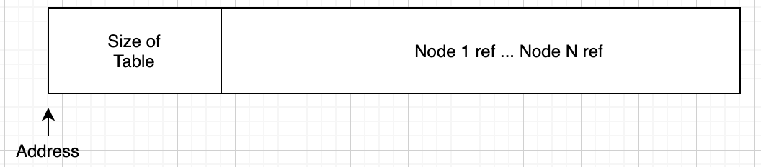
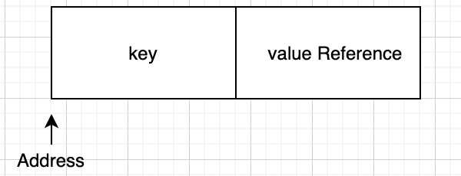
Our Implementation
Our Map (16 bytes)
Our Table (min 20 bytes)
Our Node (8 bytes)

Slide 9
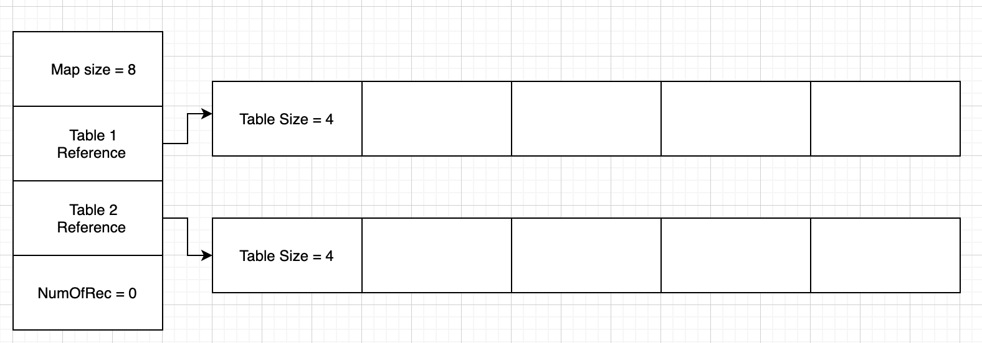
Our Implementation (Cont.)
Upon Map initialization

Slide 10
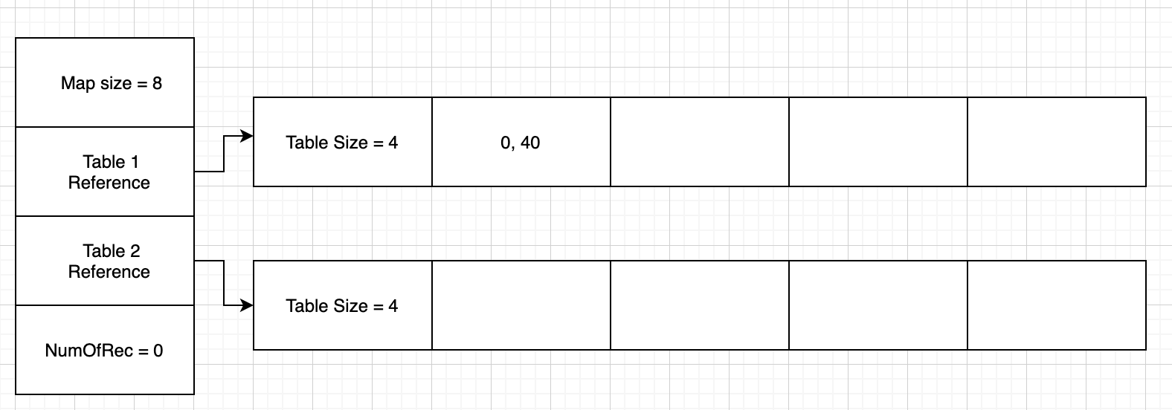
Our Implementation (Cont.)
Insert <0, 40>
1

Slide 11
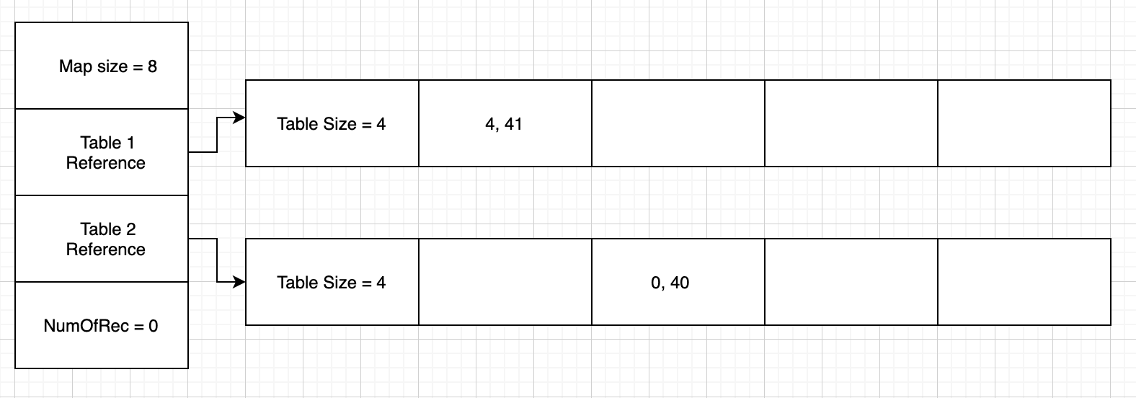
Our Implementation (Cont.)
Insert <4, 41>
2

Slide 12
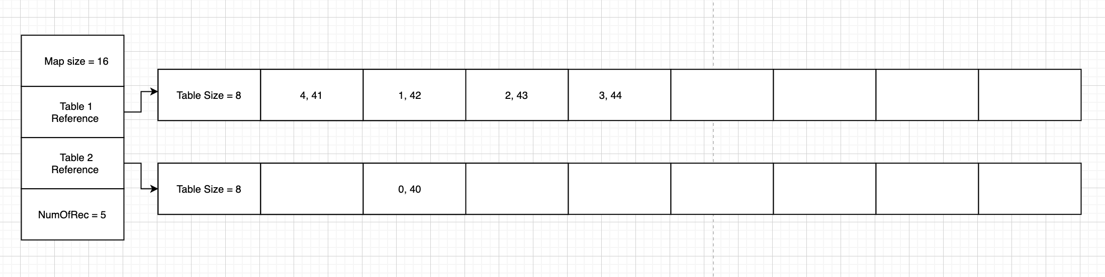
Our Implementation (Cont.)
Number of Records > Size of Map / 2
Allocate new tables with 2x sizes

Slide 13






Our Map Syntax in P0
Map declaration:
Map initialization:
Map insert:
Map get:
Map length:
Key in map:

Slide 14
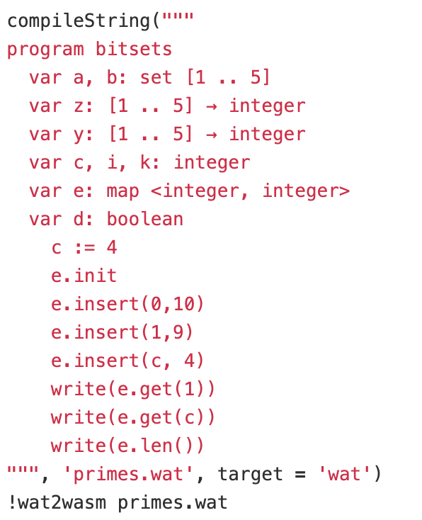

Sample Execution
Output
A
B
C
D

Slide 15
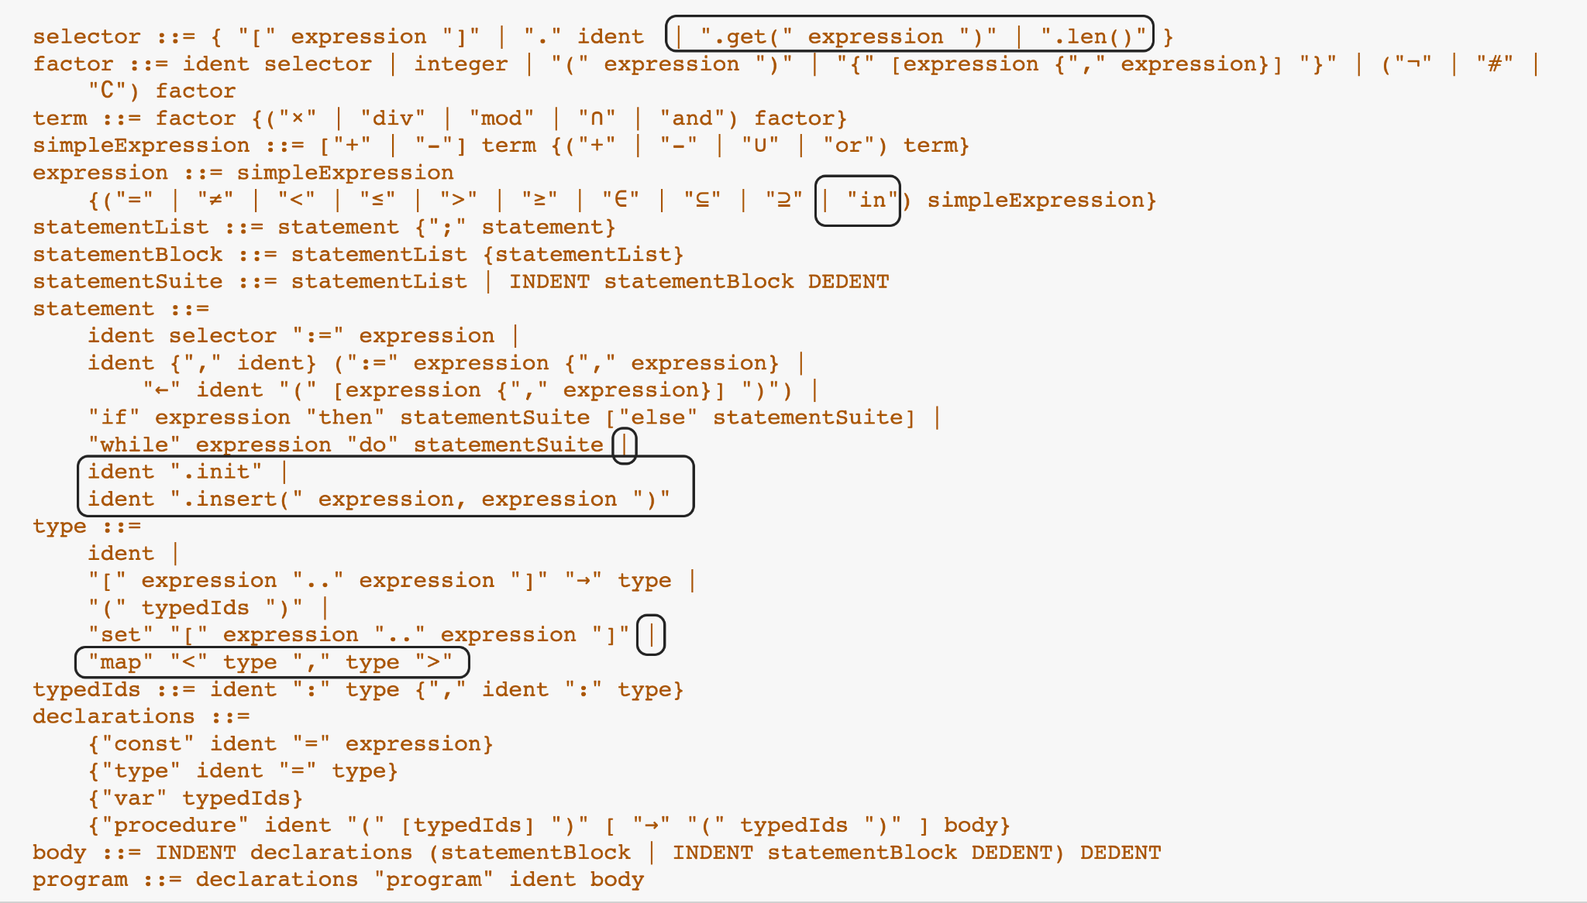
Modified P0 grammar

Slide 16
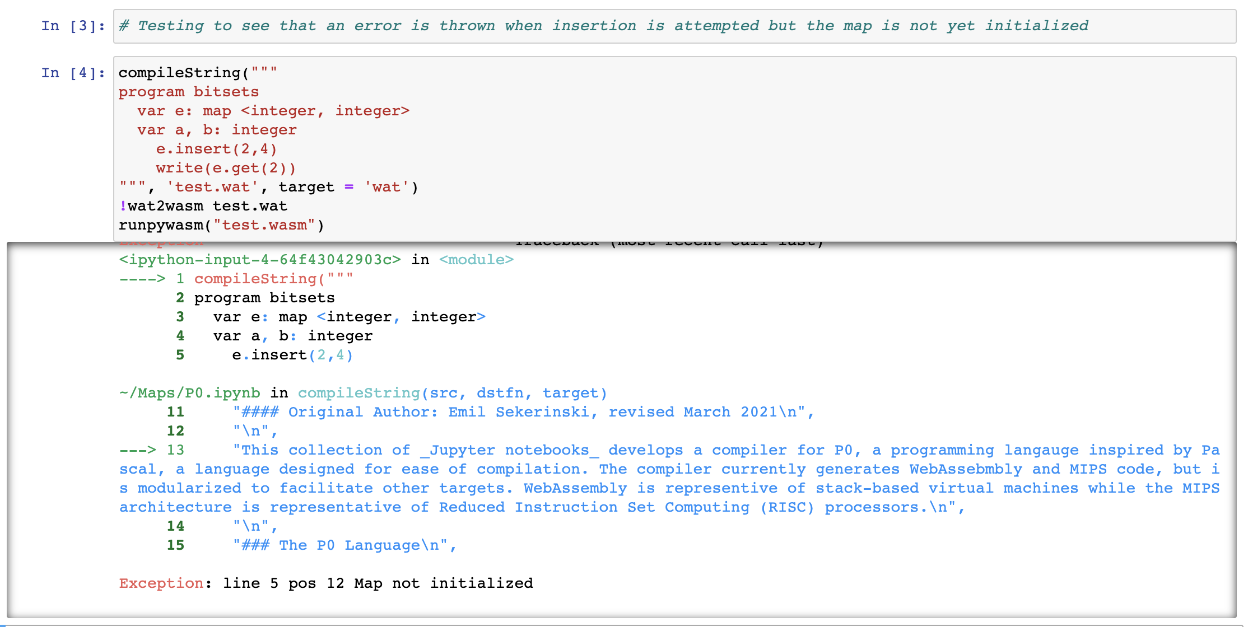
P0 Test

Slide 17
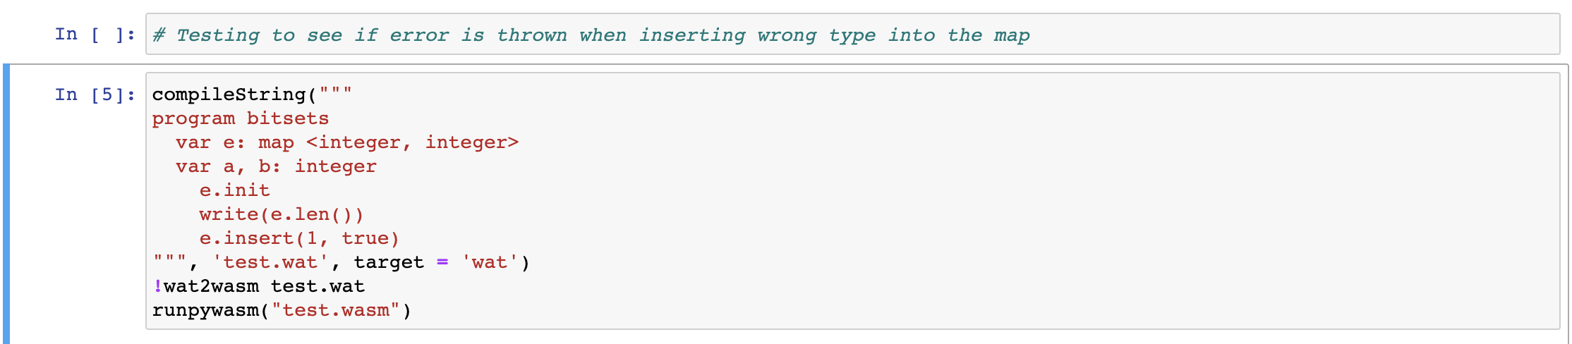
P0 Test

Slide 18
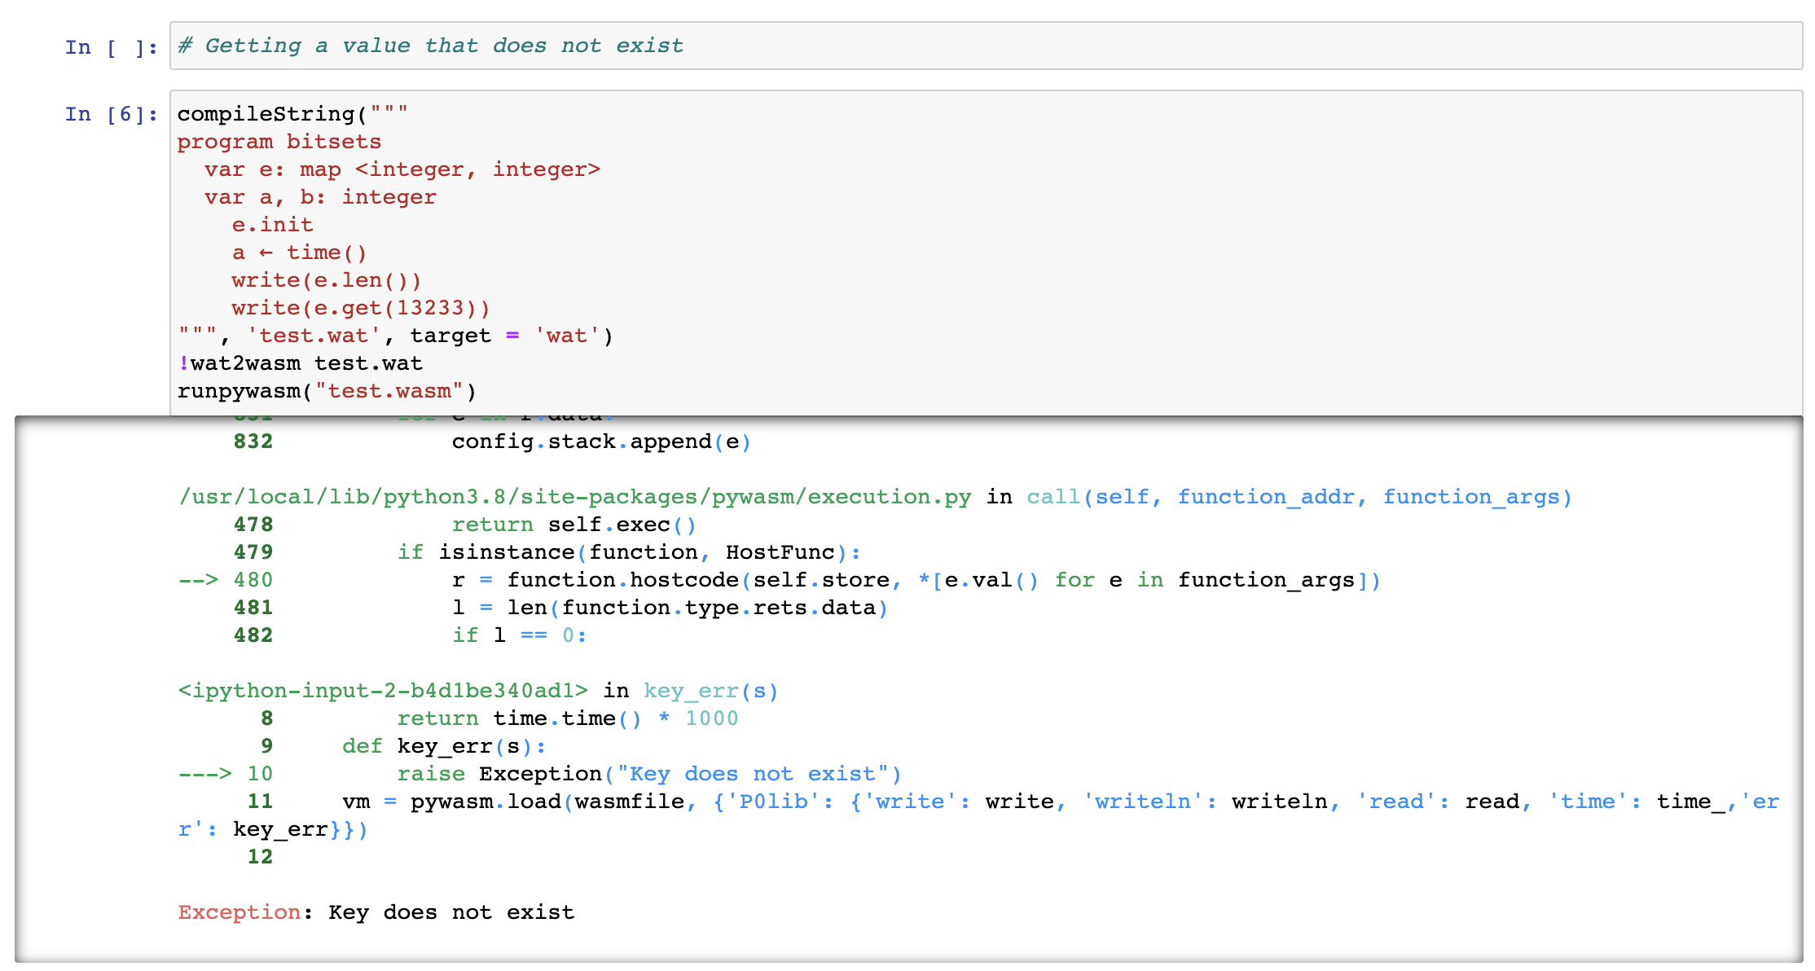
P0 Test

Slide 19
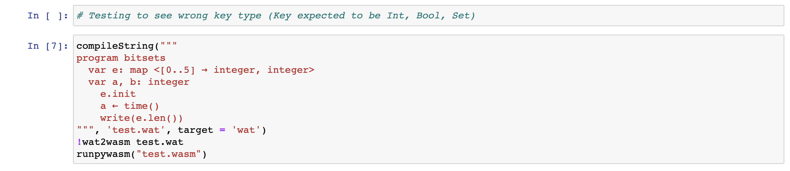
P0 Test

Slide 20
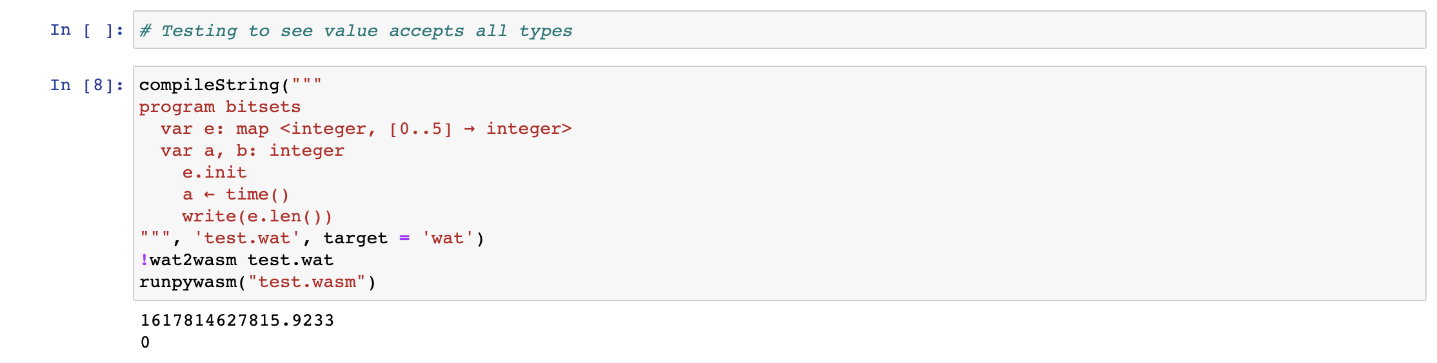
P0 Test

Slide 21
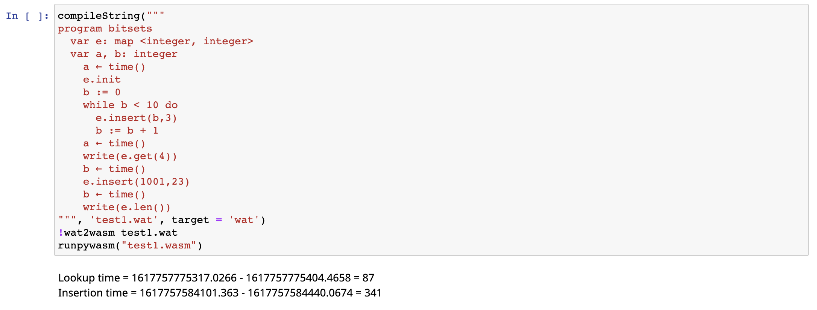
Runtime Test
Map size = 11

Slide 22
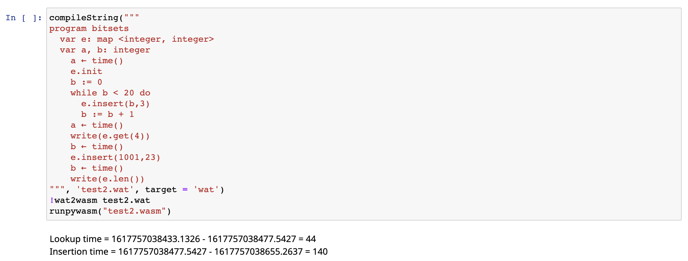
Runtime Test
Map size = 21

Slide 23
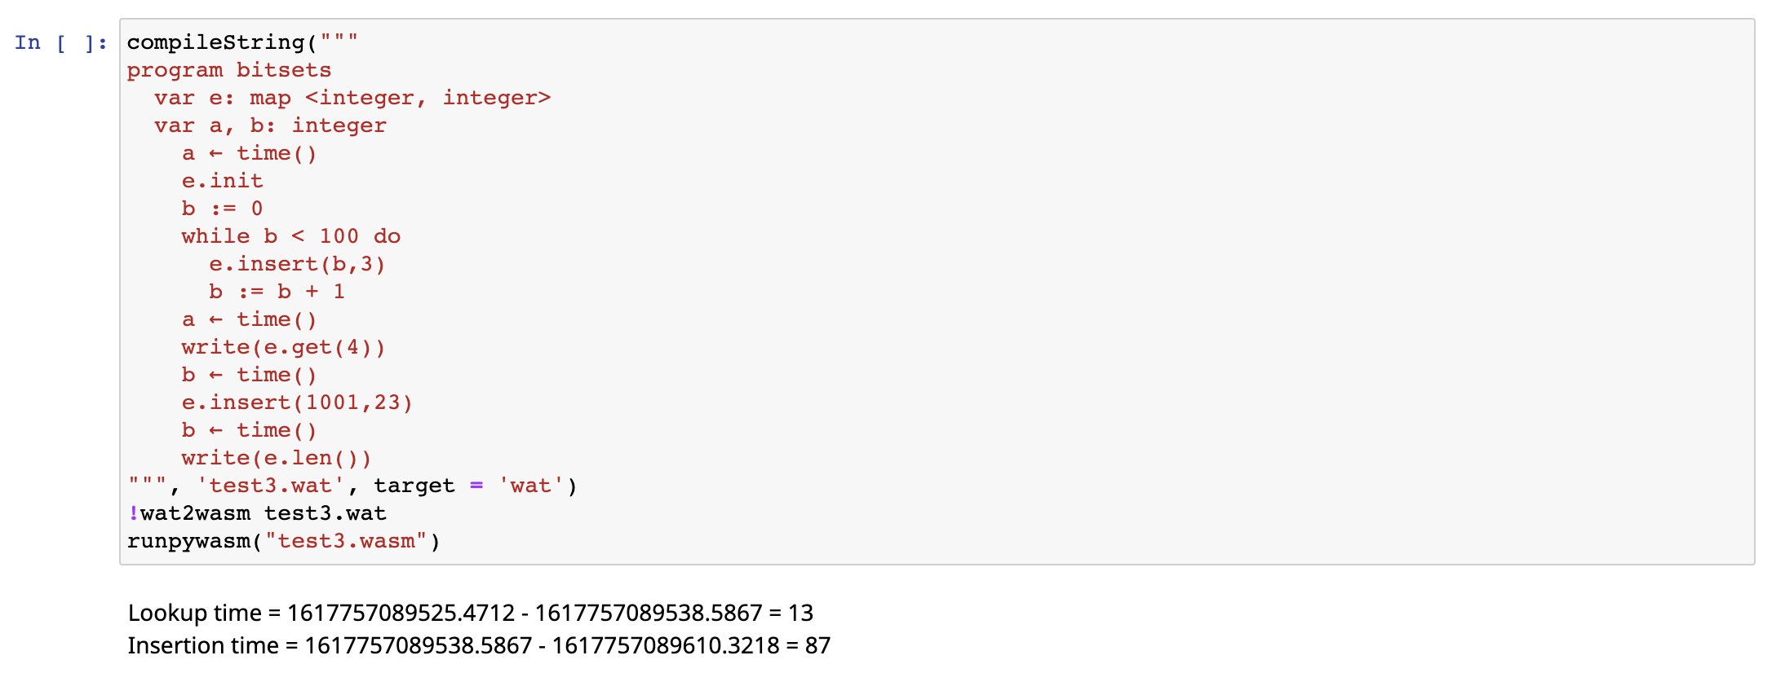
Runtime Test
Map size = 101

Slide 24

Runtime Test
Map size = 1001

Slide 25
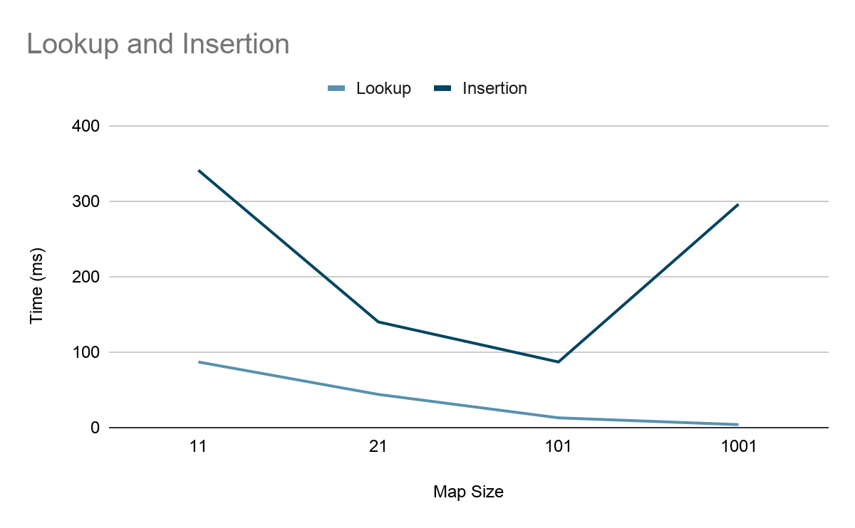
Runtime Test Summary
Size | Lookup Time (ms) | Insertion Time (ms)
11 | 87 | 341
21 | 44 | 140
101 | 13 | 87
1001 | 4 | 296

Slide 26
Development Statistics
65 lines of code added to the P0 Compiler:
385 lines of code(500+ instructions) for the map implementation using Cuckoo Hashing in Web Assembly
4 runtime and performance tests
8 “expected exceptions” tests
80 lines of documentation

Slide 27
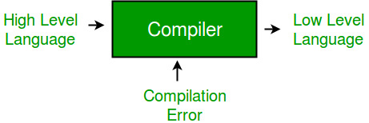
Conclusion
Map’s start at a finite size, as you add to them the size increases
Managing the memory and size is complex to do in webassembly
When choosing a key value, you can only use types that are hashable

